Slide 1
Global Nature of the Aviation Industry
Student’s Name
Institutional Affiliations
Date

Slide 2

Project Sunrays
The coronavirus pandemic altered everything in society, including the aviation industry
More requirement was created to change the agreements with international aviation partners concerning carrying hazardous materials
Project sunrays were established with TIACA and Pharma. Aero organizations on agreement of creating proper rules and regulations of vaccine supply chain (TIACA, n.d)
The project agreement is to assist Air Cargo Industry to be prepared for the unparalleled challenge
The guidelines provided are also given to major agencies and airports across the world
Notes:
The coronavirus pandemic resulted in substantial changes in every part of individuals' life; however, TIACA is a not-for-profit organization in the United States and Pharma. Aero, an organization in Belgium, decided to work together and adjust the requirements for carrying hazardous materials and other substances restricted by air. The two organizations agreed and established the Sunrays project to help create suitable guidelines and regulations for the vaccine supply chain worldwide (TIACA, n.d). The transportation of vaccines may face several challenges, and they realized that open communication is critical in ensuring preparedness in the industry. On the other hand, Sunray's project did not provide the rules to Air Cargo only but other major agencies and airports around the globe.

Slide 3
TIACA Efficient Association to Global Aviation
TIACA organization is involved in Air Cargo Stakeholders such manufacturers and shippers
Also, TIACA embraces modern technologies and procedures to sustainably and fairly serve the trade and social development world
Project Sunrays was developed to offer an internationally recognized Air Cargo representation (Pharma Aero, n.d)
Accelerates organization of overlying global regulations for Air Cargo
Operates with agencies to realize actionable safety and security energies
Notes:
TIACA operates with its employees with industry associates and controllers to advocate and bring change for a benign, lucrative and united air cargo industry. The organization is involved in air cargo shareholders, including manufacturers and shippers and also it holds for modern technologies and procedures to maintainable and fair-trade operations and societal advancement in the world. TIACA provides the best globally recognized air cargo-based depiction for developed and novel entry transporters (Pharma Aero, n.d). Moreover, the project hastens the harmonization of overlapping global guidelines for air cargo. Finally, TIACA operates with agencies to realize the actionable protected and secured energy. The organization representing the air cargo supply chain international can easily open up new links in other regions that are developing quickly.

Slide 4
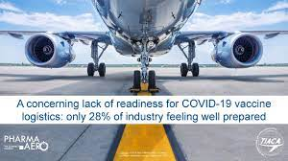
Project Sunrays Contributions
Unit Load Devices for cold storage needs power or Hazardous materials waivers
Lithium-ion batteries are usually not accepted in some aircraft
The effects of not executing agreements hinder the manufacture and delivery of vaccines (Harry, 2021)
Exceptional storage needs have resulted in new problems
Tracking and monitoring needs electronic discharge
Notes:
Project Sunrays was created to contribute to inefficient vaccine delivery by providing suitable information to the required teams. This has made them contribute to different factors, such as solving emerging problems. For example, Unit Load Devices used in cold storage need will require power or hazardous materials waivers. Also, other information presented that made project Sunrise to be efficient is to address issues such as Lithium-ion batteries which are not required to be transported by some planes, the effects of not implementing agreements results in hindrances in the manufacture and delivery of vaccines and exceptional storage required has resulted to more issues because the vaccines are bundled together, and their transportation may require specialized storage (Harry, 2021). Finally, it tracks and monitors issues that need electronic emissions, such as the general packet radio service.

Slide 5
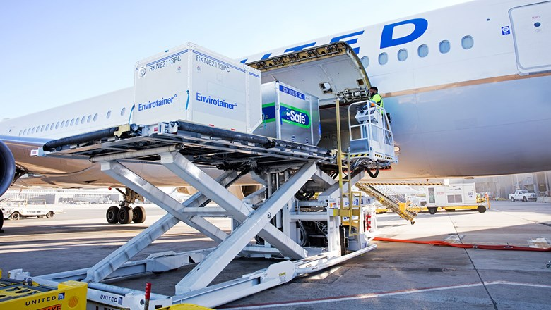
Disadvantages and future necessities
Both TIACA and Pharma Aero are paid organizations
The advantage of involving in this association is admission to a global resource
Another challenge is the operating groups and task force talk to all stakeholders (Harry, 2021)
TIACA is responsible for enabling communication among global agencies
The future necessity concerns the problem of handling specialized cargo such as vaccines
Notes:
The new agreement between the two organizations has several limitations despite providing efficient contributions to the aviation industry. For instance, both TIACA and Pharma Aero are paid organizations; therefore, more money will be spent to facilitate the project operation. Although the association benefits from accessing global resources, which are vital in promoting more tactical agreement with other partners, the operating groups and task force organize talks with other stakeholders such as the pharma and border controls (Harry, 2021). Also, TIACA is accountable for starting conversations with other global agencies such as the world health organization. Similarly, one future necessity that requires consideration is carrying specialized products such as vaccines because they are temperature sensitive and of high value.

Slide 6
More Information
International Air Transport Association (Cherkashchenko & Morozova, 2021)
Cargo Airline Association
Hazardous materials can cause substantial effects on individuals or the environment
Transportation security agency
International air cargo transport association
Notes:
Project Sunrays has allowed effective transportation of coronavirus vaccines by providing suitable information to relevant authorities. The international air transport association sustains aviation standards for airline protection, safety efficacy and sustainability (Cherkashchenko & Morozova, 2021). On the other hand, the cargo airline association is a countrywide speech for individuals of all cargo air transport industries and other people who are contingent on the services. Carrying hazardous materials has been a great challenge to the aviation industry because some airplanes cannot carry them due to the substantial effects it has on individuals or the environment. the transport security agency was created to ensure safety in the transportation system; therefore, all cargo must be screened before transported on passenger aircraft. Lastly is the international air cargo transport association, which unites all elements of the Air Cargo Industry, such as ground handlers and manufacturers.

Slide 7
References
Cherkashchenko, V. I., & Morozova, M. A. (2021). THE ROLE OF CARGO TRANSPORTATION AND METHODS OF ENSURING THE SMOOTH OPERATION OF CIVIL AVIATION ENTERPRISES DURING THE SPREAD OF A NEW CORONAVIRUS INFECTION. Modern Science, (1-1), 41-43.
Harry, R. (2021). TIACA and Pharma. Aero highlight the importance of the air cargo community approach in vaccine transportation. Air cargo news. https://www.aircargonews.net/people/tiaca-and-pharma-aero-highlight-importance-of-air-cargo-community-approach-in-vaccine-transportation/
Pharma Aero. (n.d). Project Sunrays. http://pharma.aero/sunrays
TIACA (n.d). Transportation of COVID- 19 Vaccines. https://tiaca.org/sunrays/

